Slide 1
.NET Framework Training Report
By: Pushpasri
Date:09/10/2025

Slide 2
Overview
.NET Framework
OOP concepts
C# fundamentals
Exception handling
Data Structure
Algorithm
Collections & Generics
LINQ
Version Control with Git
1

Slide 3
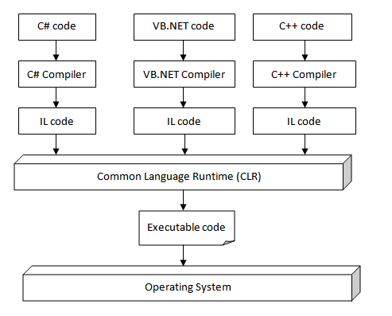
.NET Framework
Programming Languages → C#, VB.NET, F#, etc.
Compiler → Converts code into MSIL (Microsoft Intermediate Language).
CLR (Common Language Runtime) → Executes the MSIL.
BCL (Base Class Library) → Predefined classes for I/O, collections etc.
Application Types → WinForms, WPF, ASP.NET, Console Apps, etc.
2

Slide 4
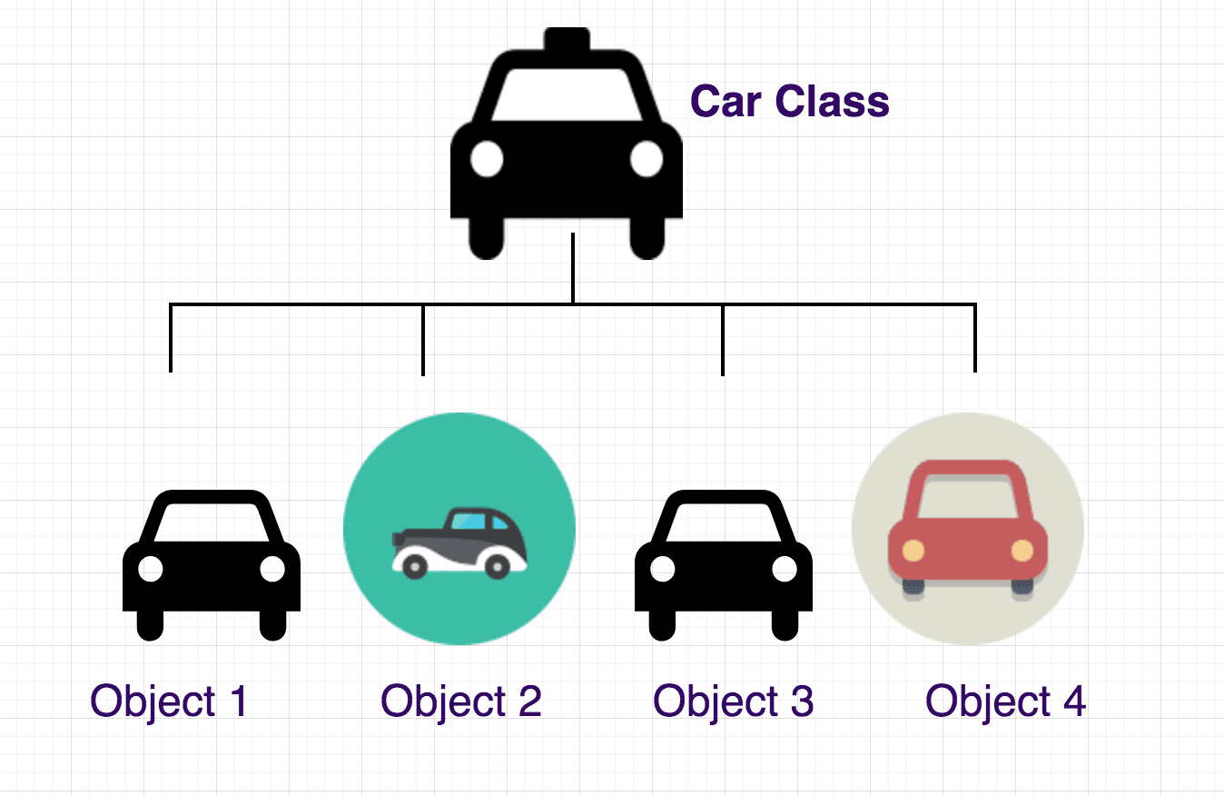
OOP Basic
Class:
A class is a blueprint — it tells what a car should have and what it can do. It’s just a plan, not a real car yet.
Class: Car Design
Object: Car
Method: Start(),Stop(),Speed()
Attribute: Color, Brand
3

Slide 5
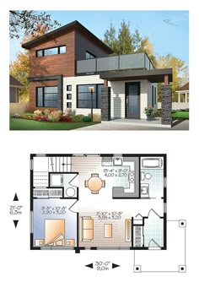
OOP Basic
Use of a Class:
A class is used to group related data (attributes) and actions (methods) together — so we can create real-world objects easily in programming.
Example:
“Just like an architect’s plan for a house — you can use it to build many houses (objects) with the same structure but different colors or sizes.”
helps us to:
Organize code neatly
Reuse code easily
Avoid repetition
4

Slide 6
OOP Basic
Object
An object is a real-world entity created from a class.
It has data (attributes) and can perform actions (methods) defined in the class.
Class: Car Design
Object: Car
Method: Start(),Stop(),Speed()
Attribute: Color, Brand
5

Slide 7
OOP Basic
Use of an Object:
Each object holds its own data-Store data Objects can call methods from the class- Perform actions Reusability-One class can create many different objects Code organization
Example:
“Just like an architect’s plan for a house — you can use it to build many houses (objects) with the same structure but different color or sizes.”
You can build many houses (objects) from the same plan (class), but each can have different:
Color
Sizes
Decorations
6

Slide 8
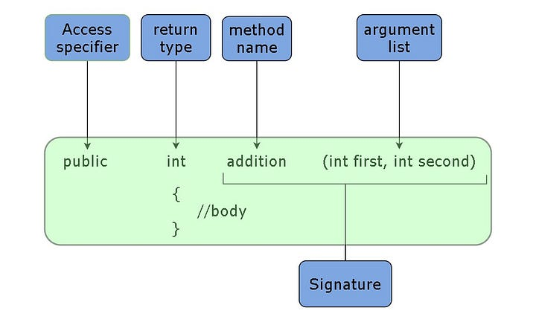
OOP Basic
Method
A method is a function inside a class that defines an action or behaviour of an object.
Class: Car Design
Object: Car
Method: Start(),Stop(),Speed()
Attribute: Color, Brand
7

Slide 9
OOP Basic
Use of Method:
Perform actions — defines what an object can do. Organize code — keeps tasks in separate blocks instead of writing everything in Main(). Reuse code — you can call the same method multiple times instead of repeating code. Take inputs and give outputs — methods can process data and return results.
Ex:
OpenDoor();
8

Slide 10

1.OOP
Abstraction
Abstraction is a concept in object-oriented programming that hides unnecessary details and shows only essential features to the user.
As a homeowner, you don’t need to know how the walls are constructed, how the electricity wiring works, or how the plumbing is done.
9

Slide 11
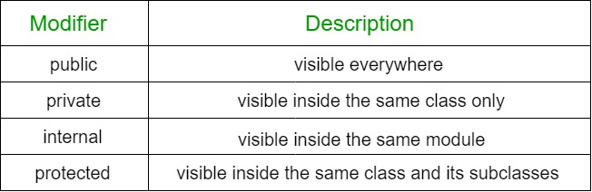
2.OOP
Encapsulation
Encapsulation is wrapping data (attributes) and methods together and restricting direct access to some parts of an object.
Example:
It has walls and floors (these are like the house’s private data).
You cannot touch or change them directly from outside.
You need Key to go access the room.
10

Slide 12
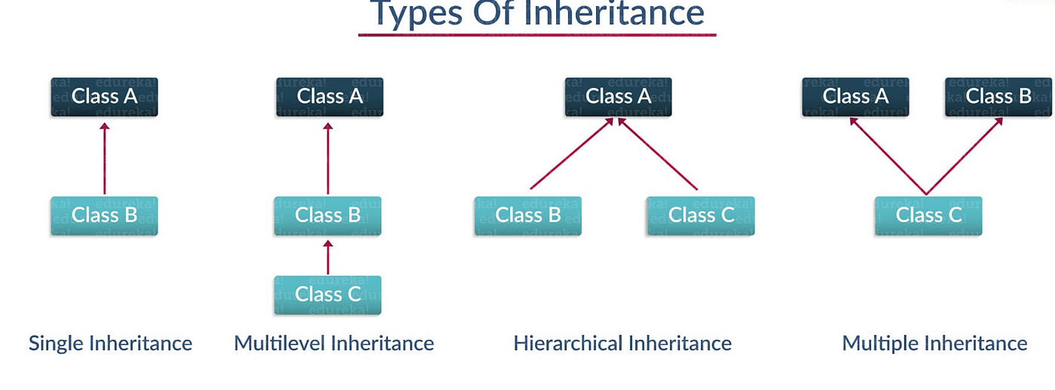
3.OOP
Inheritance
Inheritance is when one class (child) takes properties and methods from another class (parent).
Example:
Child Class: LuxuryHouse
Inherits everything from House
Adds new features: SwimmingPool(), Garden()
11

Slide 13
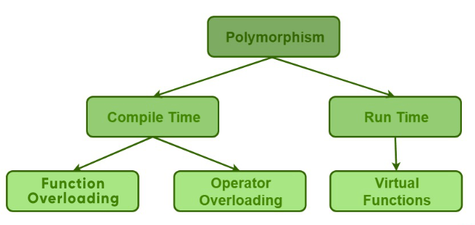
4.OOP
Polymorphism
Enables objects to take many forms, allowing the same method to behave differently.
12

Slide 14
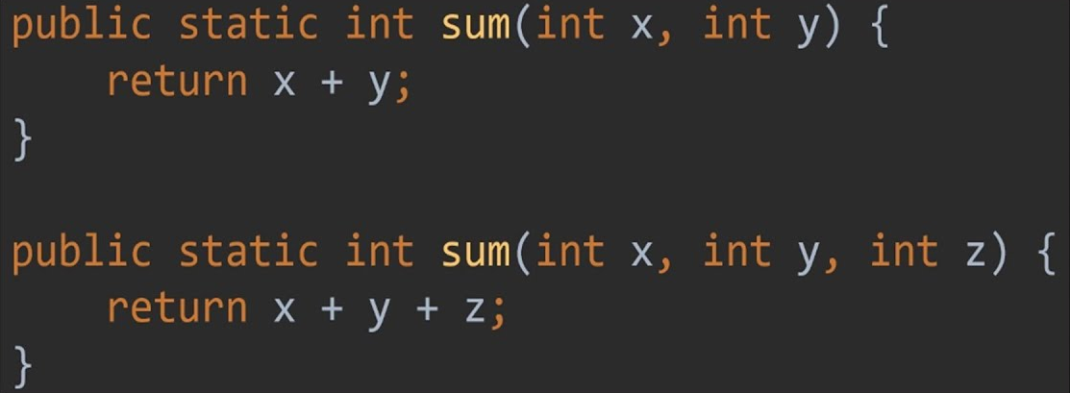
4.OOP
Compiler Time
Method Overloading → Same method name, different parameters
13

Slide 15
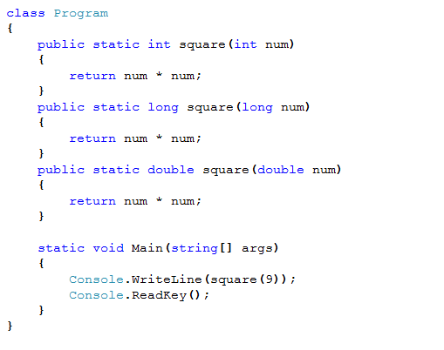
4.OOP
Compiler Time
Operator Overloading →Same operator, behaves differently for different data types
14

Slide 16
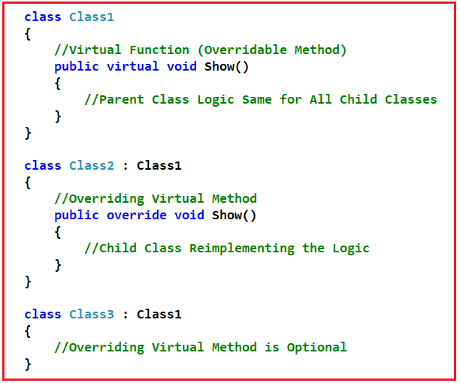
4.OOP
Run Time
The decision about which method to call is made at runtime.
Achieved using:
Method Overriding → Child class provides its own version of a parent class method
Base-Keyword can be used to access the parent class method in child class
Ex: when client Don’t like blueprint design of actual house that have Swimming pool, He make some changes in particular area in parking place
15

Slide 17
1.C# Fundamentals
Data Types: Value types, Reference types (string, arrays, objects).
Integral types (int, byte, long, etc.)
Floating-point types (float, double, decimal)
Character type (char)
Boolean type (bool)
String
Arrays
objects
Variables: Named storage locations
local
global
Const
16

Slide 18
2.C# Fundamentals
Operators: Perform operations (Arithmetic, Relational, Logical, Assignment, Ternary).
Control Structures: Direct program flow using if-else, switch, loops, break/continue, Foreach.
Methods: Define actions or behaviors that objects of a class can perform.
Classes: Blueprints or templates used to create objects.
Objects: Instances of classes that hold data and can use methods.
Constructors: Special methods used to initialize objects when they are created.
17

Slide 19
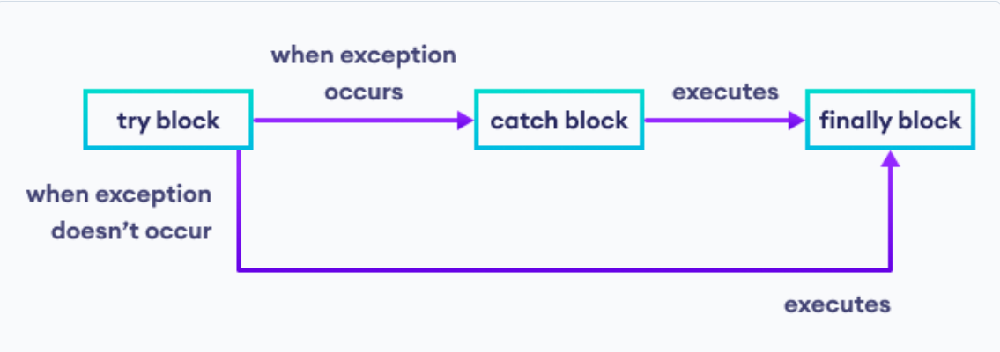
Exception Handling
Try-Catch: Handles runtime errors by “try” a block of code and “catch” exceptions if they occur.
Custom Exceptions: User-defined exceptions for handling specific error conditions in a program.
18

Slide 20
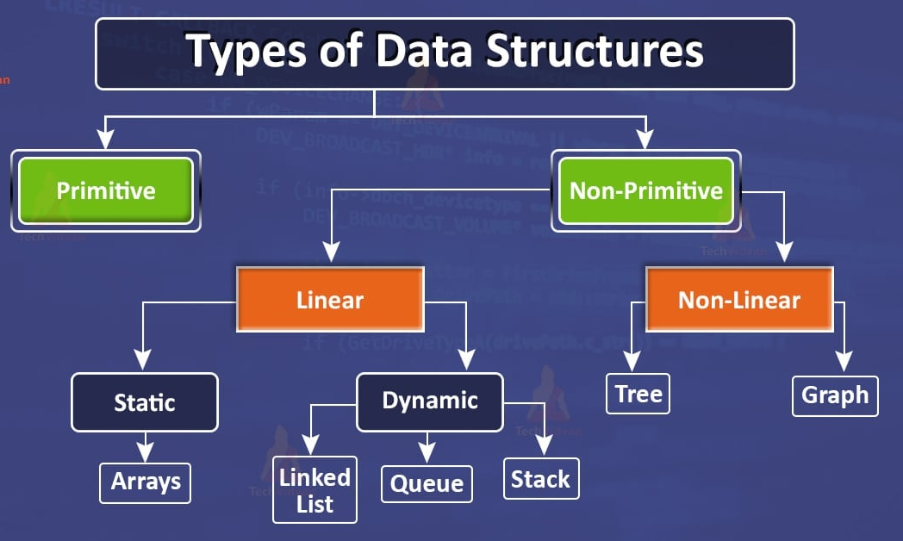
Data Structure
Data structure is a way to store organised data so that it can be used efficiently.
Primitive Data Structure
Primitive data types are basic, built-in data types that hold single values.
Non Primitive Data Structure
Non-primitive data types are derived from primitive types or user-defined types. They can hold multiple values or complex data
19

Slide 21

Linear Data Structures
Arrays
Arrays are defined as a collection of similar types of data items stored in a continuous memory location. It can be accessed by using its index number.
Example:
A cinema hall has 10 seats in a row.
Each seat can either be empty or booked( if booked no space then not allowed watch show)
Array = Fast, indexed access (fixed size).
20

Slide 22
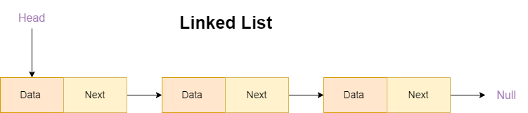
Linear Data Structures
Linked List
A linked list is a data structure that contains sequence of nodes where every node is connected to the next node by its reference pointer in its own way.
Example: Music Playlist (Next/Previous songs)
Type Of LinkedList
Singly Linked List
Doubly Linked List
Circular Linked List
Linked List = Flexible, dynamic data structure.
21

Slide 23

Linear Data Structures
Linked List
Concept Example:
Each train coach = one node
Each coach has passengers (data) and a link to the next coach
You can add or remove a coach without touching the other coaches
22

Slide 24
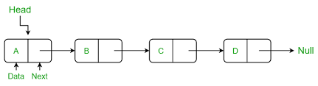
Linear Data Structures
Singly Linked List
A singly linked list is a fundamental data structure, it consists of nodes where each node contains a data field and a reference to the next node in the linked list.
23

Slide 25
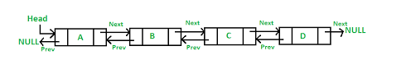
Linear Data Structures
Double Linked List
The main advantage of a doubly linked list is that it allows for efficient traversal of the list in both directions. This is because each node in the list contains a pointer to the previous node and a pointer to the next node.
24

Slide 26

Linear Data Structures
Double Linked List
Example:
Reading a Book
Each page = node
You can go to the next page or go back to the previous page
Each page stores: Content (data)Link to next page Link to previous page
25

Slide 27
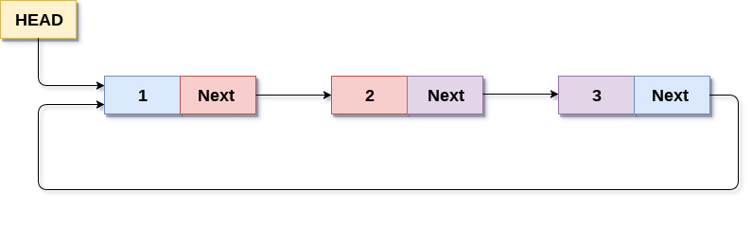
Linear Data Structures
Circular Linked List
A circular linked list is a data structure where the last node points back to the first node, forming a closed loop.
Types of Circular Linked List
Singly Linked List as Circular
Doubly Linked List as Circular
26

Slide 28
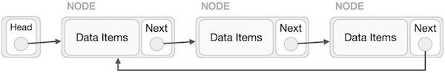
Linear Data Structures
Singly Linked List as Circular
In singly linked list, the next pointer of the last node points to the first node.
27

Slide 29
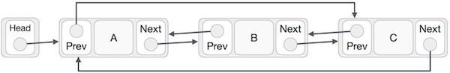
Linear Data Structures
Doubly Linked List as Circular
In doubly linked list, the next pointer of the last node points to the first node and the previous pointer of the first node points to the last node making the circular in both directions.
28

Slide 30
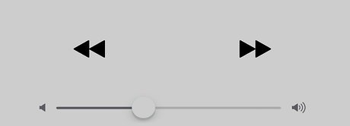
Linear Data Structures
Circular Linked List
Music Playlist on Repeat
Songs are played in a loop
After the last song, it automatically goes to the first song
29

Slide 31

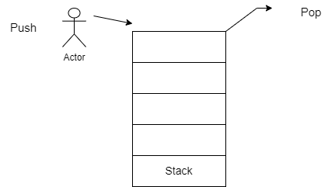
Linear Data Structures
Stack
A stack is a linear data structure that follows the LIFO principle approach for accessing each element. LIFO stands for Last in First Out. The basic operations in stack are Push, Pop, Peak (or Top).
Example: Plate Stack in a Canteen
When new plates are washed, they’re placed on top of the stack. When someone takes a plate, they take from the top. So the last plate placed will be the first plate taken.
Stack Operations
Push(x) → Insert element to top
Pop() → Remove the top element.
Peek()/Top() → Get the top element without removing it.
30

Slide 32
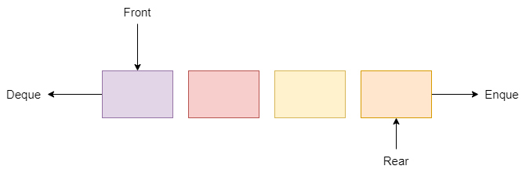
Linear Data Structures
Queue
A queue can be defined by as an ordered list which enables insert operation to be performed and one end called the Rear end and other Delete operation can be performed by another end called as Front. Queue is referred to as the First in First Out (FIFO).
Type Of Queue
Simple Queue
Circular Queue
Double Ended Queue (Deque)
Priority Queue
31

Slide 33
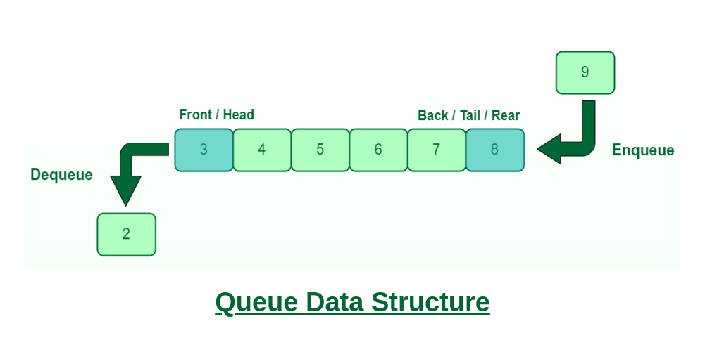
Linear Data Structures
Simple Queue
Definition: a linear FIFO (First-In-First-Out) structure: elements are inserted at the rear and removed from the front.
Core Operation
Enqueue(x) — add at rear
Dequeue() — remove from front
Peek() / Front() — view front without removing
Example: Ticket Counter People waiting in line for tickets or boarding a bus. The first one in line gets the service first.
32

Slide 34
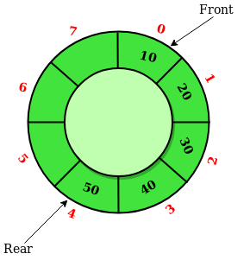
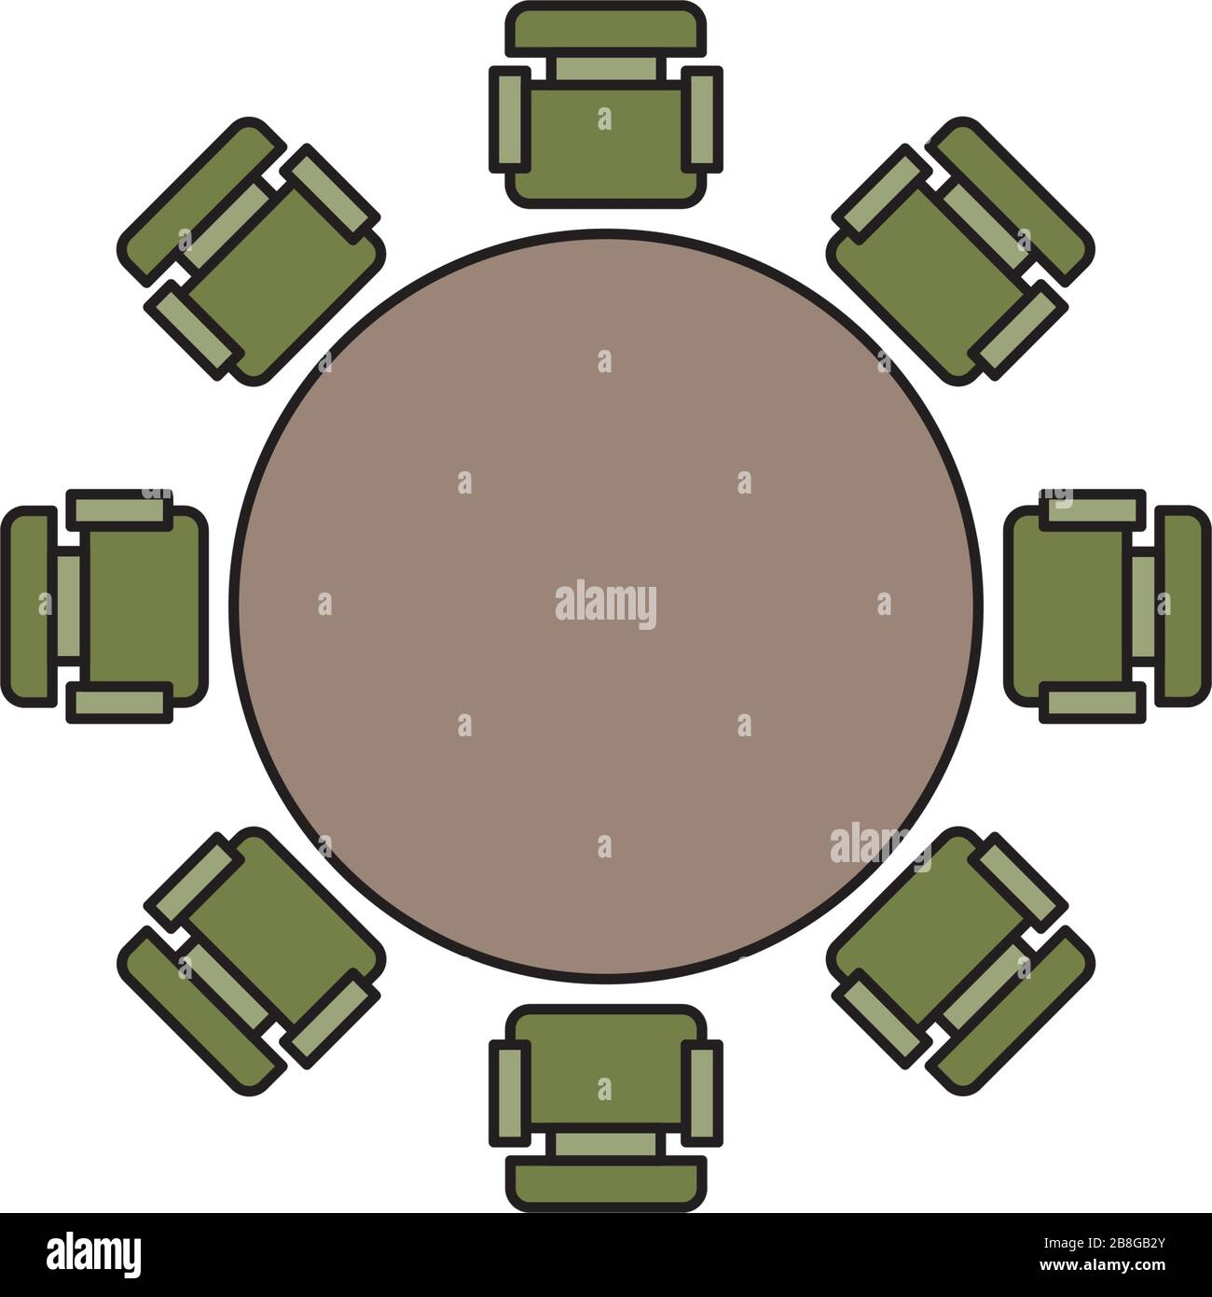
Linear Data Structures
Circular Queue
Definition: Circular Queue is just a variation of the linear queue in which front and rear-end are connected to each other to optimize the space wastage of the Linear queue and make it efficient.
Why:
In a normal queue, once the queue becomes full, we cannot insert the next element even if there is a space in front of the queue. But using a circular queue, we can use the space to insert elements.
33

Slide 35
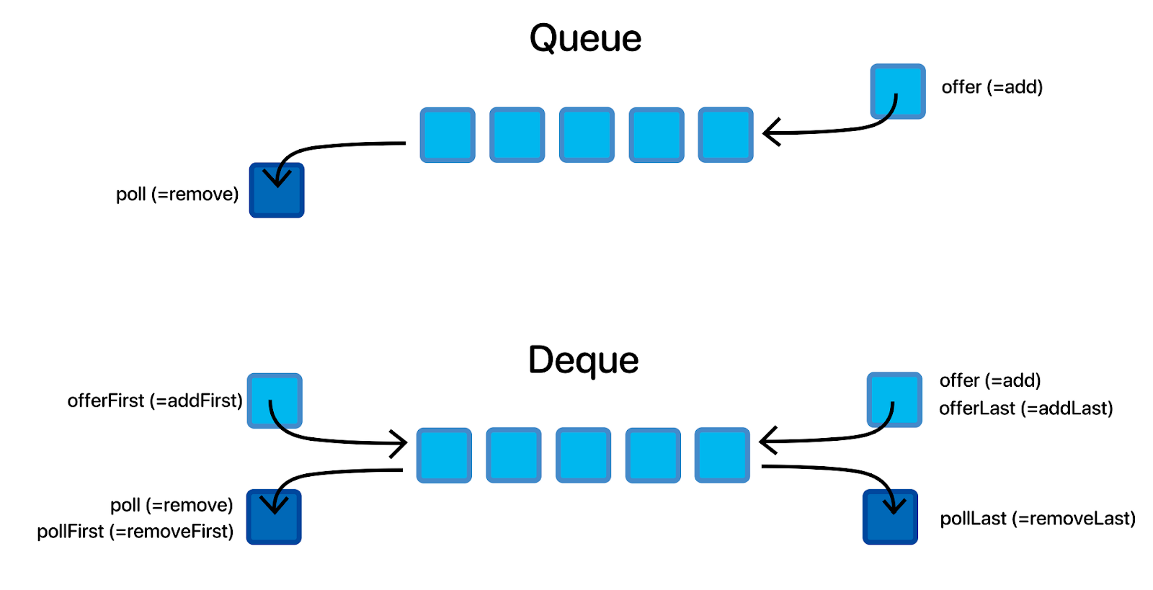
Linear Data Structures
Deque
Deque is a hybrid data structure that combines the features of a stack and a queue. It allows us to insert and delete elements from both ends of the queue. The name Deque is an abbreviation of Double-Ended Queue.
Deque Example(Temple line)
Imagine a train ticket counter:
Normal customers join at the rear of the line.
VIP customers can go to the front of the line.
People leave the front when served, but sometimes the counter can also let someone leave from the back if they cancel their request.
34

Slide 36
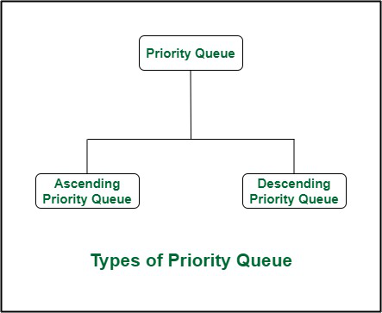
Linear Data Structures
Priority Queue
In a priority queue, generally, the value of an element is considered for assigning the priority. For example, the element with the highest value is assigned the highest priority and the element with the lowest value is assigned the lowest priority.
Patients arrive in any order, but critical patients are treated first.
Example:
Patient A (Minor cut) → low priority
Patient B (Heart attack) → high priority
Patient C (Fracture) → medium priority
Treatment order:
Patient B → first
Patient C → second
Patient A → last
priority matters more than arrival time
35

Slide 37
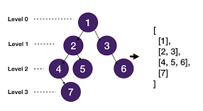
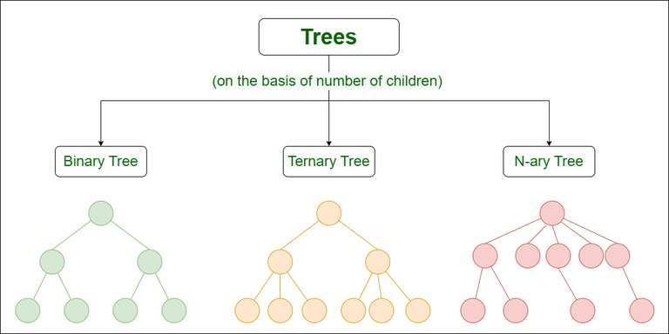
Non-Linear Data Structures
Tree
A tree is a data structure that represents hierarchy of the data. A tree data can be defined recursively as a collection of nodes, where each node is a list of reference to that node.
36

Slide 38
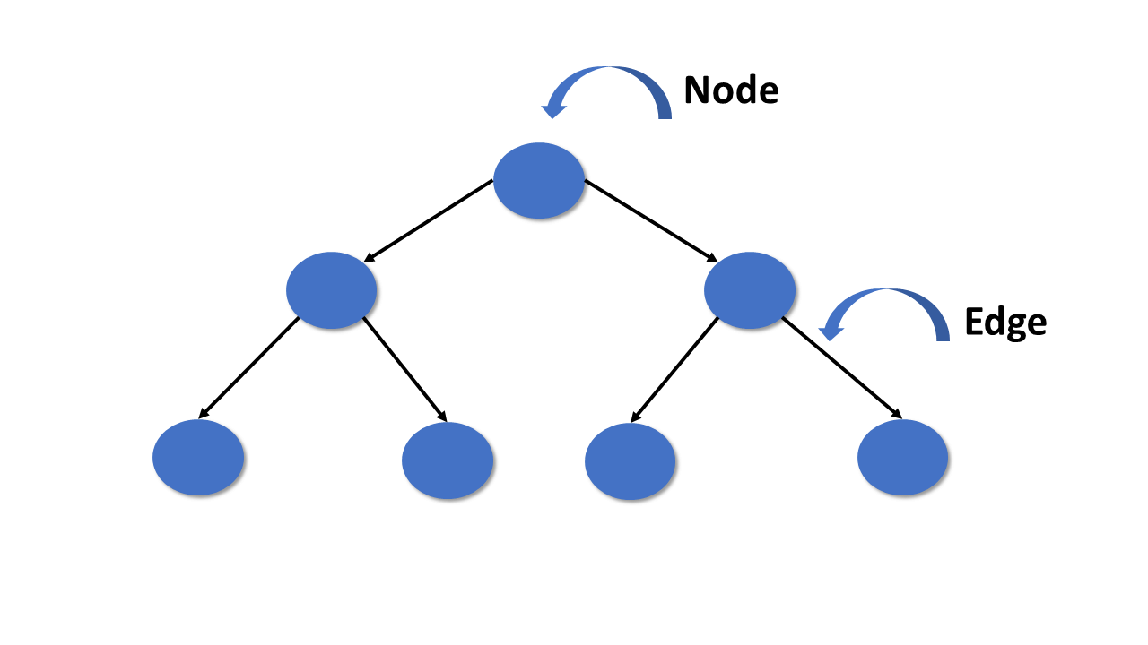
Non-Linear Data Structures
Tree
Example: Library Book Classification
Books (Root)
├ Fiction
│ ├ Fantasy
│ └─ Mystery
└─ Non-Fiction
├Science
└─ History
Books
Non-Fiction
Fiction
Fantasy
Mystery
Science
History
37

Slide 39
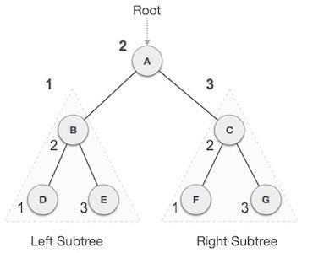
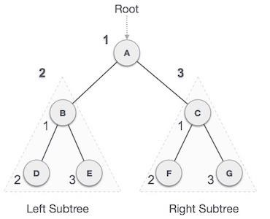
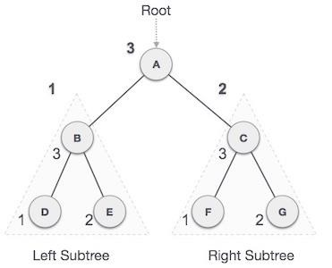
Non-Linear Data Structures
Tree Traversal
Traversal is a process to visit all the nodes of a tree and may print their values too. Because, all nodes are connected via edges (links) we always start from the root (head) node. That is, we cannot randomly access a node in a tree
In-Order
Pre-order
Post- Order
38

Slide 40
Non-Linear Data Structures
Use of Tree:
Hierarchical Representation
Represents data in levels, like company hierarchy or file system.
Efficient Searching
Especially in Binary Search Trees (BST), data can be found quickly.
Expression Evaluation & Decision Making
Used in calculators, game trees, and AI decision trees.
Database & Routing Applications
Helps in database indexing (B+ trees) and network routing.
39

Slide 41
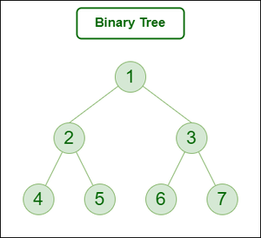
Non-Linear Data Structures
Binary Tree
A binary tree is a tree data structure in which each node can have at most two children : Left child, Right child.
Types:
Full Binary Tree
Complete Binary Tree
Perfect Binary Tree
Degenerate (or Skewed) Binary Tree
BST(Binary Search Tree)=>AVL
40

Slide 42
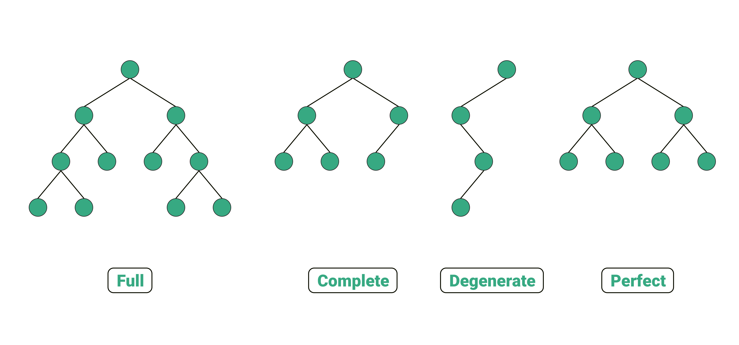
Non-Linear Data Structures
Types of Binary Tree
41

Slide 43
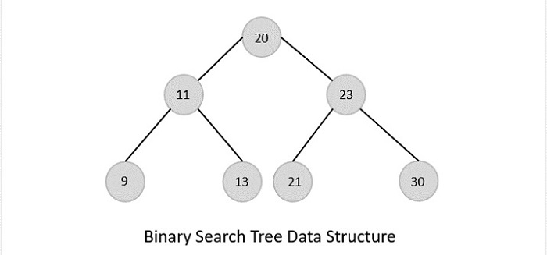
Non-Linear Data Structures
Binary Search Tree (BST)
The data in the Binary Search Trees (BST) is always stored in such a way that the values in the left subtree are always less than the values in the root node and the values in the right subtree are always greater than the values in the root node
Types:
AVL Tree
Red Black Tree
42

Slide 44
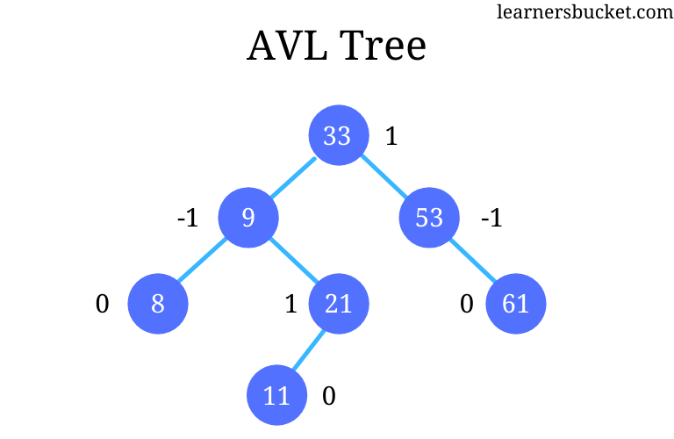
Non-Linear Data Structures
AVL Tree
In AVL trees, the difference between the heights of left and right subtrees, known as the Balance Factor(-1,0,1), must be at most one
BALANCE FACTOR = HEIGHT(LEFT SUBTREE) − HEIGHT(RIGHT SUBTREE)
If balance factor goes outside this range, the tree performs rotations to rebalance.
LL Rotations
RR Rotations
LR Rotations
RL Rotations
43

Slide 45
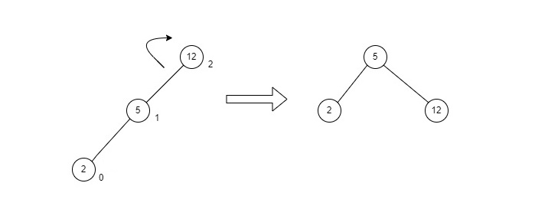
Non-Linear Data Structures
AVL Tree- rotations(LL)
LL rotation is performed when the node is inserted into the Left subtree leading to an unbalanced tree. This is a single left rotation to make the tree balanced again
44

Slide 46
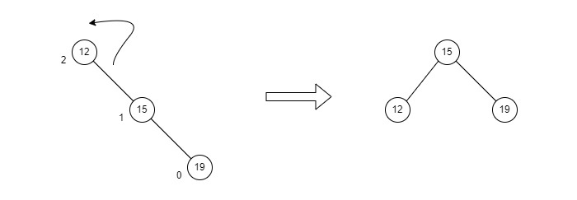
Non-Linear Data Structures
AVL Tree- rotations(RR)
RR rotation is performed when the node is inserted into the right subtree leading to an unbalanced tree. This is a single right rotation to make the tree balanced again
45

Slide 47
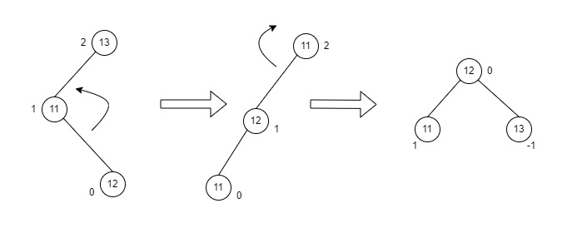
Non-Linear Data Structures
AVL Tree- rotations(LR)
LR rotation is the extended version of the previous single rotations, also called a double rotation. It is performed when a node is inserted into the right subtree of the left subtree. The LR rotation is a combination of the left rotation followed by the right rotation.
46

Slide 48
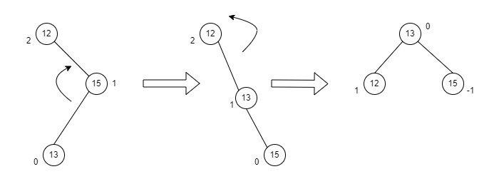
Non-Linear Data Structures
AVL Tree- rotations(RL)
RL rotation is also the extended version of the previous single rotation, hence it is called a double rotation and it is performed if a node is inserted into the left subtree of the right subtree. The RL rotation is a combination of the right rotation followed by the left rotation.
47

Slide 49
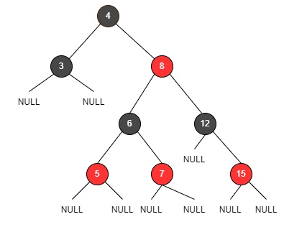
Non-Linear Data Structures
Red-Black Tree
Red-Black Tree is a self-balancing binary search tree where each node has an additional attribute: a color, which can be either red or black. The primary objective of these trees is to maintain balance during insertions and deletions, ensuring efficient data retrieval and manipulation.
Rules:
Every node is either red or black.
Root is always black.
All leaves (NIL or null nodes) are black.
Red node cannot have a red child → no two reds in a row.
Every path from a node to its leaves has the same number of black nodes → ensures balance
48

Slide 50
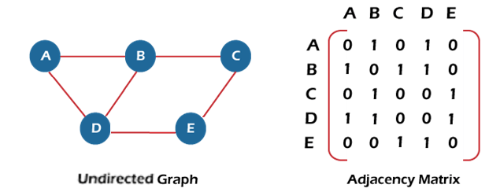
Non-Linear Data Structures
Graph
A graph can be defined as a group of nodes that are known as vertices and edges and that are used to connect that vertices. Graphs are widely used in networks, routing, social networks, etc.
Types:
1. Classification by Edge Weight
Weighted Graph
Unweighted Graph
2. Classification by Direction
Undirected Graph
Directed Graph
3. Classification by Connectivity
Cyclic Graph
Acyclic Graph
Example:
Social network → Users = nodes, Friendships = edges
City map → Locations = nodes, Roads = edges
49

Slide 51
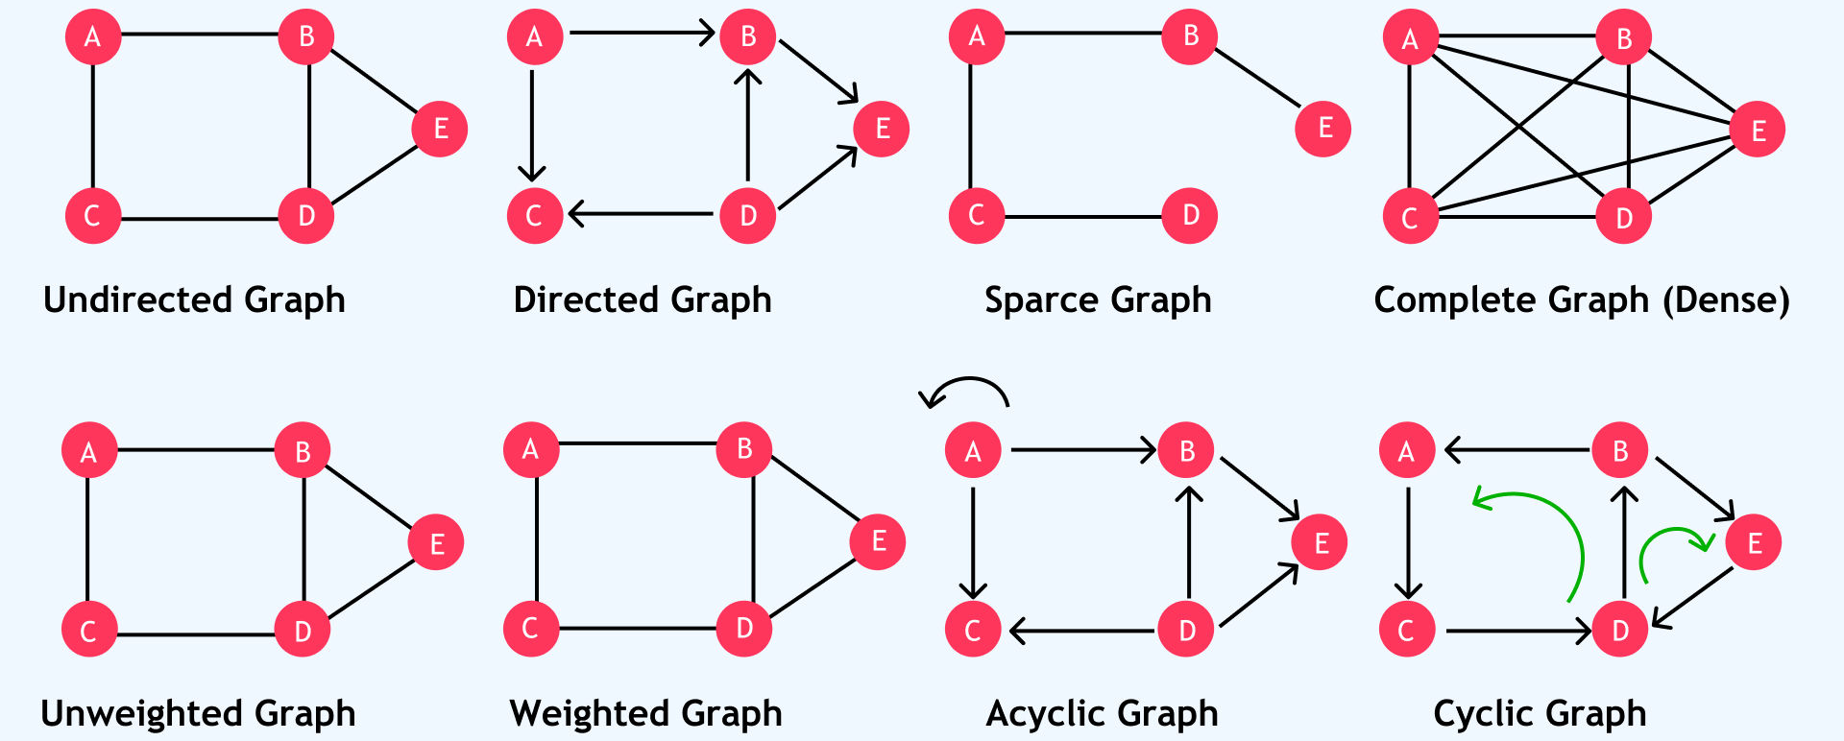
Non-Linear Data Structures
Graph
50

Slide 52
Non-Linear Data Structures
Graph
Graph Type | Real-Time Use Example
Undirected | Facebook friends, peer-to-peer networks, two-way roads
Directed | Twitter followers, web page links, workflow tasks, Web page with the Directed Links to reach another
Weighted | Google Maps, flight networks, network bandwidth
Unweighted | Social connections, simple network links
Cyclic | Computer networks with redundancy, traffic loops
Acyclic (DAG) | Project scheduling, Git commit history, build pipelines
51

Slide 53
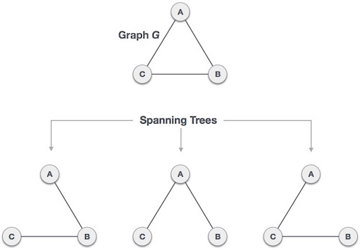
Non-Linear Data Structures
Graph-Spanning Tree
A spanning tree is a subset of Graph G, which has all the vertices covered with minimum possible number of edges. Hence, a spanning tree does not have cycles and it cannot be disconnected..
spanning tree algorithms:
Kruskal's Algorithm
Prim's Algorithm
52

Slide 54
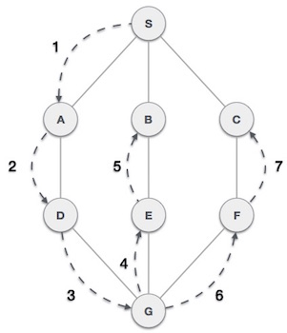
Non-Linear Data Structures
Graph Traversal (Depth First Search Traversal)
This algorithm traverses a graph in a depth ward motion and uses a stack to remember to get the next vertex to start a search, when a dead end occurs in any iteration.
53

Slide 55
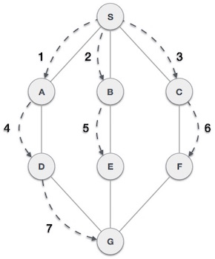
Non-Linear Data Structures
Graph Traversal (Breadth First Search Traversal)
Breadth First Search (BFS) algorithm traverses a graph in a breadth ward motion to search a graph data structure for a node that meets a set of criteria. It uses a queue to remember the next vertex to start a search, when a dead end occurs in any iteration.
54

Slide 56
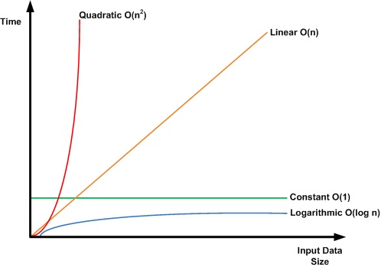
Algorithm
An algorithm is a step-by-step procedure or set of rules to solve a problem or perform a task. Think of it like a recipe in cooking—it tells you exactly what steps to follow to get the final result.
Sorting Algorithm
Searching Algorithm
Greedy Algorithm
Divide and Conquer
Dynamic Algorithm
55

Slide 57
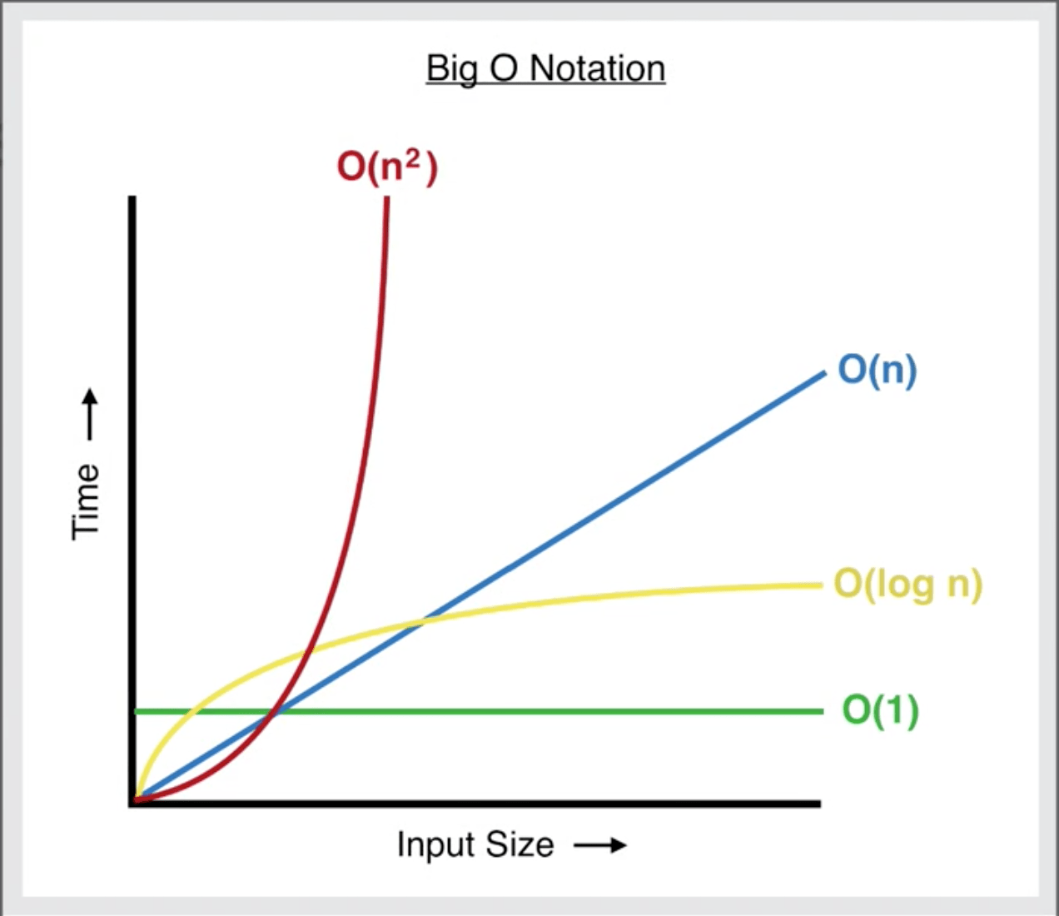
Time & Space Complexity
Definition: Time complexity measures how the running time of an algorithm grows as the size of the input increases & Space complexity measures how much extra memory (space) an algorithm needs as the input size increases.
Usually expressed using Big O notation (O(f(n))).
Types:
O(1)-Constant
O(n)-Linear
O(log n)-Logarithmic
O(n )- Quadratic
2
It tells us: “If I double my input, how much longer time and space will it take?”
56

Slide 58
Sorting Algorithms
Sorting = Arranging data in ascending or descending order.
Improves efficiency in searching, organizing, and processing data.
Type of Sorting
Bubble Sort
Selection Sort
Insertion Sort
Merge Sort
57

Slide 59
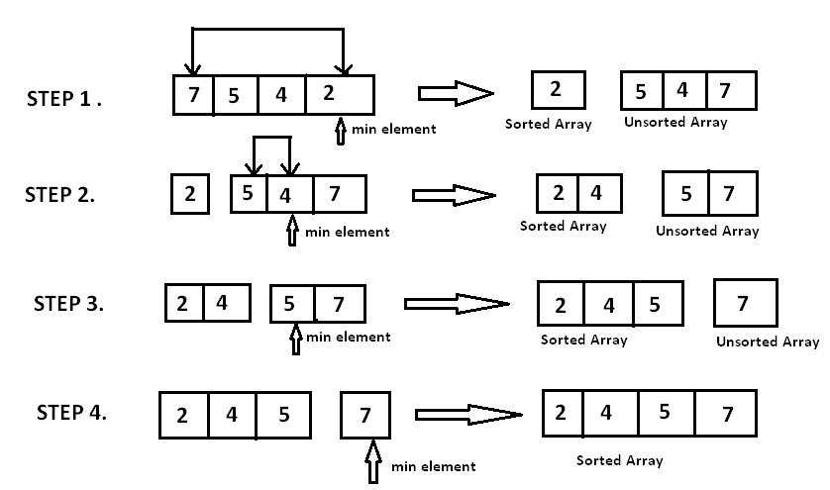
1.Sorting Algorithms
Selection Sort
Definition: Finds the smallest element and puts it in the correct position.
58

Slide 60
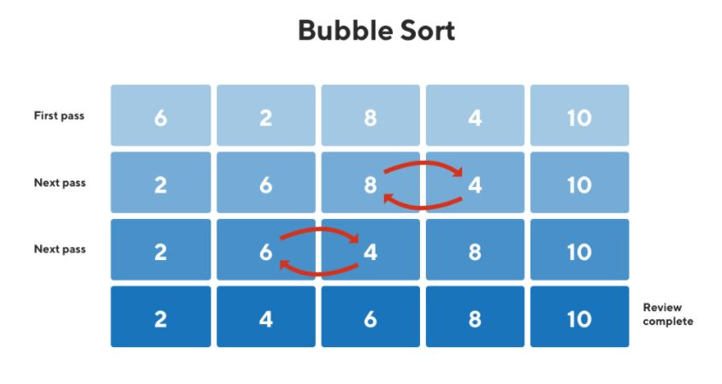
2.Sorting Algorithms
Bubble Sort
Definition: Repeatedly swaps adjacent elements if they are in wrong order.
59

Slide 61

3.Sorting Algorithms
Insertion Sort
Definition: Builds the sorted array one element at a time.
60

Slide 62

4.Sorting Algorithms
Merge Sort
Definition: Divide and Conquer sorting algorithm.
It divides the array into halves, sorts each half, and then merges them
61

Slide 63
Greedy Algorithm
A Greedy Algorithm is an algorithmic approach that makes the best possible choice at each step, hoping that these local optimum choices will lead to a global optimum solution.
Example: Minimum Spanning Tree (MST)
Some Algorithms :
Kruskal's algorithm
Prim's Algorithm
Dijkstra’s Algorithm
“Take the best choice available right now, without worrying about the future.”
62

Slide 64

Greedy Algorithm
Kruskal's algorithm
Kruskal’s Algorithm is a greedy algorithm that builds the MST by sorting all edges by weight and then repeatedly adding the smallest edge to the MST, provided it doesn’t form a cycle, until all vertices are connected.
63

Slide 65

Greedy Algorithm
Prim
Prim’s Algorithm is a greedy algorithm that builds the MST by starting from a single vertex and repeatedly adding the minimum-weight edge that connects a vertex in the tree to a vertex outside the tree, until all vertices are included.
64

Slide 66

Greedy Algorithm
Dijkstra’s Algorithm
the goal is to find the shortest distance from a given source node to all other nodes in the graph. Ex:OSPF (Open Shortest Path First)=>Routing
65

Slide 67


Searching Algorithm
Searching algorithms are techniques used to find the location of a target element within a data structure like an array, tree, or graph.
Types:
Linear Search
Binary Search
66

Slide 68

Searching Algorithm
Linear Search- A searching method that checks each element in a list one by one until the desired element is found or the list ends[T-C=O(n)].
67

Slide 69

Searching Algorithm
Binary Search-A searching method on sorted data that repeatedly divides the search interval in half to quickly locate the target. [T-C=O(log n)]
68

Slide 70

Shortest path algorithms
A shortest path algorithm is a method used to find the minimum distance or minimum cost path between nodes in a graph.
Type:
Dijkstra’s Algorithm
Bellman-Ford Algorithm
Floyd-Warshall Algorithm
BFS
69

Slide 71

Bellman-Ford Algorithm
Purpose: Finds the shortest paths from a single source to all vertices in a weighted graph.
Special Feature: Supports negative weight edges, unlike Dijkstra
Ex: RIP (Routing Information Protocol) in computer networks uses Bellman-Ford to calculate the shortest path from a router to all other routers.
70

Slide 72

Floyd-Warshall Algorithm
Floyd Warshall algorithm is a great algorithm for finding shortest distance between all vertices in graph.
It can be used with negative weights, although negative weight cycles must not be present in the graph.
71

Slide 73

Divide and Conquer
Definition : Divide and Conquer is an algorithm design where a problem is solved by
Divide → Break the problem into smaller sub-problems of the same type.
Conquer → Solve each sub-problem recursively.
Combine → Merge the solutions of sub-problems to get the final solution.
Example:
Merge Sort
Binary Search
72

Slide 74

Collections & Generics
Collection
Collections are data structures that store and manage groups of objects.
They provide flexible ways to store, retrieve, and manipulate data, compared to simple arrays.
Type:
Arrays
Advanced Collection
73

Slide 75

Collections & Generics
BOXING
Boxing is the process of converting a value type (like int, float, bool) into a reference type (specifically an object).
UNBOXING
Unboxing is the reverse process — converting a boxed object back to a value type.
74

Slide 76

Collections & Generics
Non-Generic
A non-generic class, method, or collection works with a specific data type. It does not provide type safety at compile-time, and you may need explicit typecasting when retrieving data.
Generic:
A generic class, method, or collection allows you to write type-safe, reusable code that works with any data type. The type is specified at compile-time, eliminating the need for typecasting.
75

Slide 77

Non-Generics
Non-Generic
A non-generic collection is a collection that can store objects of any type (different data types together), because it stores them as object
This require boxing and unboxing
Example: Imagine you are creating a simple logging system for a small app that stores different types of information (integers, strings, boolean) in a single list or dictionary.
76

Slide 78


Non-Generics-ArrayList
It is a non-generic, resizable array.
Unlike a normal array, it can grow or shrink dynamically when you add or remove elements.
Stores all elements as object, so it can hold different data types together
77

Slide 79

Non-Generics
HashTable
A Hashtable is a non-generic collection that stores data in key-value pairs.
Keys must be unique, but values can repeat.
it uses a hashing technique to quickly locate values based on their keys.
A hash function is a function that converts input data of any size into a fixed-size value, usually an integer.
The output is called a hash code.
Hash functions are used to quickly look up data, like in hash tables.
78

Slide 80

Generics
Generic
The actual data type is specified when you use it.
Found in System.Collections.Generic namespace.
Avoid Boxing and Unboxing.
List<T>
List<T> is a generic collection that acts like a dynamic array.
Stores elements of a single, specific type (T).
Automatically resizes when elements are added beyond its current capacity
79

Slide 81


Generics
Dictionary<TKey, TValue>
A generic collection that stores key-value pairs.
Each key is unique;
the value can be anything.
Provides fast lookups using hashing.
80

Slide 82

Generics
Stack<T>
A stack is a LIFO (Last-In-First-Out) data structure.
Last item pushed → first item popped.
Generic version: Stack<T> (type-safe, no casting required).
81

Slide 83

Generics
Queue<T>
A queue is a FIFO (First-In-First-Out) data structure.
First item enqueued → first item dequeued.
Generic version: Queue<T> (type-safe, no casting required).
82

Slide 84
LINQ
LINQ (Language Integrated Query) is a feature in C# that allows you to query collections of data (arrays, lists, databases, etc.) in a SQL-like syntax directly within C# code.
LINQ can replace loops for filtering, ordering, grouping, and selecting data.
CODE(Query syntax):
int[] numbers = { 1, 2, 3, 4, 5 };
var evenNumbers = from n in numbers
where n % 2 == 0
select n;
CODE(using Lambda(method syntax)):
int[] numbers = { 1, 2, 3, 4, 5 };
var evenNumbers = numbers.Where(n => n % 2 == 0);
83

Slide 85

Lambda
A shortcut to write tiny functions.
Helps LINQ know what to look for.
Example: g=>g. Genre;
means ‘Get the Genera equals to Adventure!’, g is just a temporary name for each item
84

Slide 86
Common LINQ Methods
Operation | Method Example | Description
Filter | Where() | Select elements meeting a condition
Transform | Select() | Change shape or value of elements
Sort | OrderBy(), OrderByDescending() | Sort elements
Group | GroupBy() | Group elements by a key
Aggregate | Count(), Sum(), Average(), Max(), Min() | Perform calculations
Find / Check | First(), FirstOrDefault(), Any() | Get first element or check existence
85

Slide 87



Example of Linq
Consider a Class that has declare some data properties
Then Assign values for the list of defined data properties.
86

Slide 88


Linq Selection
Without LINQ:
Now access the value of Title in the list using normal loop.
With LINQ:
Rewrite the loop with the Select function to make the code more concise and expressive.
87

Slide 89

Linq Filtering
Use the Where method to filter games based on a specific condition, such as matching a genre.
This method returns a subset of elements that satisfy the condition.
OUTPUT: Tetris(Show title with genre==RPG)
88

Slide 90


Linq Grouping
Organize games by genre using GroupBy.
This method creates a collection of groups, each containing elements that share a key.(if two RPG game then RPG=> key to access them)
89

Slide 91

Linq Aggregating
Aggregate = combine multiple items into one.
It is very general-purpose — anything that reduces a collection to a single value.
You can calculate sums, products, concatenations, or count and so on.
90

Slide 92
Linq Aggregating
You can calculate sums, products, concatenations, or count and so on.
Function | Description | Example
Sum() | Calculates sum of numeric collection | numbers.Sum()
Min() | Returns minimum value | numbers.Min()
Max() | Returns maximum value | numbers.Max()
Average() | Returns average value | numbers.Average()
Count() | Returns number of elements | numbers.Count()
First() | Returns first element | numbers.First()
FirstOrDefault() | Returns first element or default | numbers.FirstOrDefault()
Last() | Returns last element | numbers.Last()
LastOrDefault() | Returns last element or default | numbers.LastOrDefault()
Any() | Checks if any element satisfies a condition | numbers.Any(n => n > 4) → true
All() | Checks if all elements satisfy a condition | numbers.All(n => n < 10) → true
91

Slide 93

Linq Sorting
Sorting helps organize data, making it easier to analyze.
Sort games by a property like release year using OrderBy.
By default, it sort by Ascending order.
For making it to Descending order
OrderByDescending() → Descending order
92

Slide 94

LINQ-JOIN
A JOIN in LINQ is used to combine data from two collections (like two tables in SQL) based on a common key.
Example: Two different Collections and join them with common attribute department
93

Slide 95


LINQ-JOIN
OUTPUT:
94

Slide 96
Version Control with Git
Git Basics
Git is a version control system that tracks changes in your code and allows collaboration.
Common Commands:
git init → Initialize a new Git repository in the current folder.
git status → Check the current status of files (modified, staged, untracked).
git add <file> → Stage a file to be committed.
git commit -m "message" → Commit the staged changes with a descriptive message.
git push to origin → The staged code is push to the Remote repository
95

Slide 97
Version Control with Git
Branching
Branching allows you to create separate lines of development so you can work on features or fixes independently without affecting the main code.
Common Commands:
git branch → List all branches in the repository.
git branch <branch-name> → Create a new branch.
git checkout <branch-name> → Switch to a specific branch.
96

Slide 98
Version Control with Git
Merging
Merging is the process of integrating changes from one branch into another.
Typically, you merge a feature branch into the main branch after development
Git combines changes automatically if there are no conflicts; otherwise, you resolve conflicts manually.
97

Slide 99
Thank You
98

